Slide 1




Small Charity Friendly Conference:
Navigating the cost-of-living crisis with funder support
25 April 2023
@LimeGreenConslt

Slide 2


About Lime Green Consulting
Business planning
Facilitation
Theory of change
Fundraising strategy
Advice & mentoring
Case for support
Trading activities
Bid writing
Project ‘packaging’
Prospect research
Template content

Slide 3

Navigating the cost-of-living crisis with funder support
What I’ll be talking about today:
The impact of the crisis on charities & social enterprises
Calculating your rising costs
Explaining and justifying rising costs to funders
Tactics for discussing things with existing and prospective funders
How are funders stepping up to the plate?
Where to go for information and support

Slide 4


Navigating the cost-of-living crisis with funder support
The impact on charities & social enterprises

Slide 5
Navigating the cost-of-living crisis with funder support
The impact on charities & social enterprises
Your project costs & running costs are likely to be impacted by:
  Rising energy bills
  High inflation (impacting cost of services, materials, food, fuel etc.)
  Increased staffing costs (because your staff are facing the same challenges)
  Increasing demand for your services by those in need
Grants & donations aren’t going as far
Funders may have less to give after Covid & in the current landscape
In early 2022, Pro Bono Economics recently reported that:
  Organisations would need to increase salaries by 8.8% between 2021 and 2024 just to avoid a fall in wages in real terms
  A grant worth £100,000 in 2021 will be worth £94,000 by 2023

Slide 6

Navigating the cost-of-living crisis with funder support
Calculating your rising costs
Things you’re doing the same but now cost more:
Factor in increased costs due to rising energy bills and inflation if you haven’t re-budgeted recently
Identify any specific vulnerabilities (e.g. supplier contracts up for renewal, landlord clauses)
Plan for salary increases, especially for your most vulnerable staff
Apply year-on-year inflationary increases for future years

Slide 7
Navigating the cost-of-living crisis with funder support
Calculating your rising costs
Things you might need to do differently:
The cost of meeting rising service demand (e.g. increased sessional worker hours, volunteer expenses, room hire)
The cost of overcoming people’s barriers (e.g. meals, travel expenses, childcare)
The cost of doing something entirely new or different (but question whether you’re doing it for the right reasons, and you’re the right organisation to do it)

Slide 8
Navigating the cost-of-living crisis with funder support
You’ve re-calculated your costs, but how might you explain and justify this to a funder?
Financial responsibility: “To ensure that we’re able to cover all our costs and remain financially stable as an organisation, we have increased our budget for this project by x% / we are including a budget line for contingency at x% for 2023-24.”
Service quality: “To ensure that we’re able to keep providing the same quality of support to people in a challenging economic climate, and respond to people’s evolving needs in a difficult landscape, we have increased our budget for this project by x% for 2023-24.”
Service user consultation: “We’ve listened to the people we support and made some changes to ensure our service remains accessible for everyone, but this is going to cost a little more to deliver.”
Looking after your people: “To ensure that our frontline staff don’t face a fall in wages in real terms as a result of inflation, and to meet the costs of supporting them during a cost-of-living crisis, we need to…”

Slide 9

Navigating the cost-of-living crisis with funder support
Tactics for discussing things with existing and prospective funders
Update your case for support to reflect any new/changed activities: evidence base, project description, impact data
Update other comms materials, including your website, to reflect the current focus of your work!
Current funders – explore if there is any potential to renegotiate the future years of multi-year grants, explaining your reasoning
New funders – check their guidance on how to calculate
overhead costs and query any policies or limitations that
may put you at financial risk

Slide 10
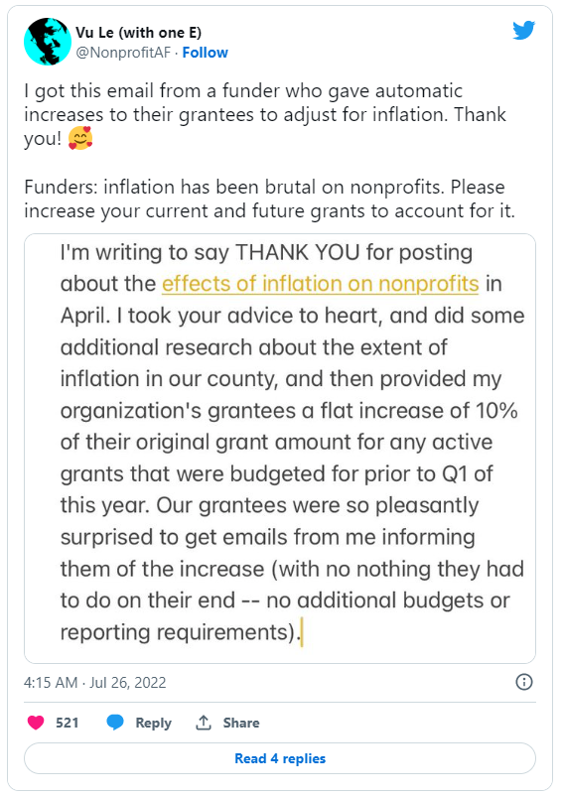

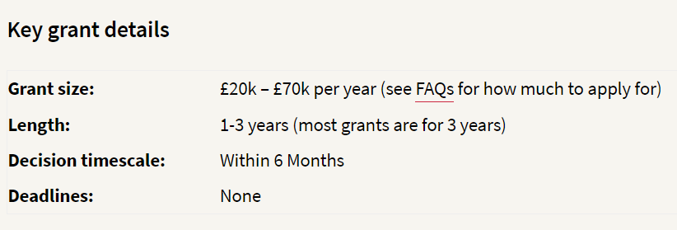
Navigating the cost-of-living crisis with funder support
How are funders responding?

Slide 11
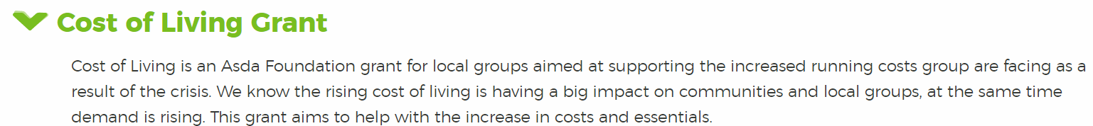






Navigating the cost-of-living crisis with funder support
How are funders responding?
(Just closed!)

Slide 12
Navigating the cost-of-living crisis with funder support
Sources of information and support (clickable links)
Charity Excellence Framework: cost-of-living funding information page
Grants Online: cost-of-living funding information page
Charity Finance Group: cost-of-living resources hub
NPC (think tank): How to talk to funders about the cost-of-living crisis
Lime Green Consulting: How charities and social enterprises can respond to the cost-of-living and energy crisis

Slide 13

Navigating the cost-of-living crisis with funder support
How can Lime Green help you?
Strategic consultancy
Fundraising strategy review / development
Bid writing support
Trusts & foundations setup: funding needs, prospect research, case for support
Free funding drop-in sessions for small charities
Fundraising & strategy blog

Slide 14
Thank you! www.limegreenconsulting.co.uk
@LimeGreenConslt

