Slide 1


Creativity and communication
in the face of uncertainty
Tuesday 25th April 2023
Creativity and communication
in the face of uncertainty
Tuesday 25th April 2023
#SCFConference
Free virtual conference helping
small charities to manage the impact
of the cost of living crisis and other challenges
with The Small Charity Friendly Collective, supported and hosted by gunnercooke LLP

Slide 2
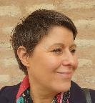
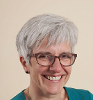
Creativity and communication
in the face of uncertainty
Tuesday 25th April 2023
09.30-09.45: “Just when we thought that things could not get any worse...”, Michele Price
09.45-10.30: Planning for financial uncertainty, Liz Pepler and Rachel Cooper
10.45-11.30: Be more creative to diversify your income, Laura Salisbury
11.45-12.30: Navigating the cost of living crisis with funder support, Mike Zywina
12.30-13.00: Lunch/Networking
13.00-13.45: Understanding what your audiences need to hear from you, Yasmin Glover
14.00-14.45: Mission, Culture and Crisis, Elizabeth Balgobin
15.00-15.45: The people perspective: uncertain times and impact on you and your employees, Sonia Wilson
15:45-16:00: Closing/questions/thanks
‘Planning for financial uncertainty’
with Liz and Rachel
at 09.45am.
#SCFConference

Slide 3


About us
Creativity and communication
in the face of uncertainty
Tuesday 25th April 2023
Liz Pepler MIAB FRSA
Rachel Cooper ACA
Charity finance and governance consultant
Founding Director, Embrace Finance
Co-Founder, Small Charity Friendly Collective
Trustee Treasurer, Association of Chairs
NCVO | Getting on Board | Lloyds Bank Foundation
Over 20 years’ experience working in and for charities
liz@embracefinance.org.uk
Chartered Accountant and charity finance specialist
Principal, Welbeck
Co-Founder, Small Charity Friendly Collective
Trustee Treasurer
NCVO | Fawcett Society | ACIE
Over 20 years’ experience working in and for charities
rachel.cooper@welbeckaccountancy.co.uk

Slide 4
Before we begin
Creativity and communication
in the face of uncertainty
Tuesday 25th April 2023
How confident are you in your ability to guide your charity through the financial futures ahead?
1
2
3
4
5
Low
High

Slide 5

Charity Finance
Finance

Slide 6
We are in uncertain times
Creativity and communication
in the face of uncertainty
Tuesday 25th April 2023

Slide 7


Creativity and communication
in the face of uncertainty
Tuesday 25th April 2023
Not possible to see far ahead at all
Too much to see

Slide 8
Is there any point in planning at all?
Creativity and communication
in the face of uncertainty
Tuesday 25th April 2023

Slide 9


We think there is
Creativity and communication
in the face of uncertainty
Tuesday 25th April 2023
There are some things we do know
Fixed costs, income end points, pipelines

Slide 10

We all have an iceberg
Creativity and communication
in the face of uncertainty
Tuesday 25th April 2023
Our business models are precarious
We all have something on our horizon which threatens to take us off the financial track unless we intervene

Slide 11

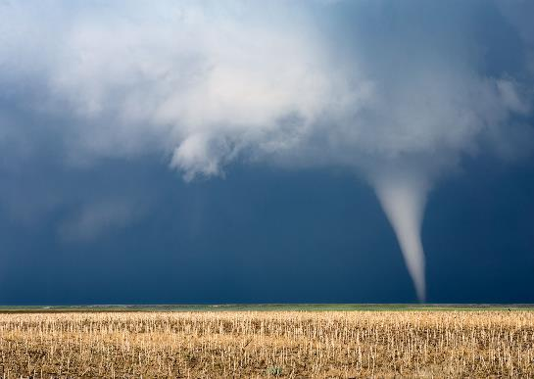
For some of us, our challenge
Creativity and communication
in the face of uncertainty
Tuesday 25th April 2023
Is near term and existential
Is far off and may pass us by

Slide 12
So, what can we do?
Creativity and communication
in the face of uncertainty
Tuesday 25th April 2023

Slide 13


We think that where
Creativity and communication
in the face of uncertainty
Tuesday 25th April 2023
Where there are financial rainstorms
There is always a financial rainbow

Slide 14

We are strongest when we are resilient
Creativity and communication
in the face of uncertainty
Tuesday 25th April 2023
‘Organisational resilience is the ability to anticipate, prepare for, adapt and respond to incremental change and sudden shock in order to survive and thrive’
Cranfield School of Management

Slide 15

Anticipating
Creativity and communication
in the face of uncertainty
Tuesday 25th April 2023
Annual budget
Actual v budget
Forecasts
Longer term financial strategy
Are we surviving, sustaining, thriving?
Now, next year, in 3 years? In 10 years?

Slide 16
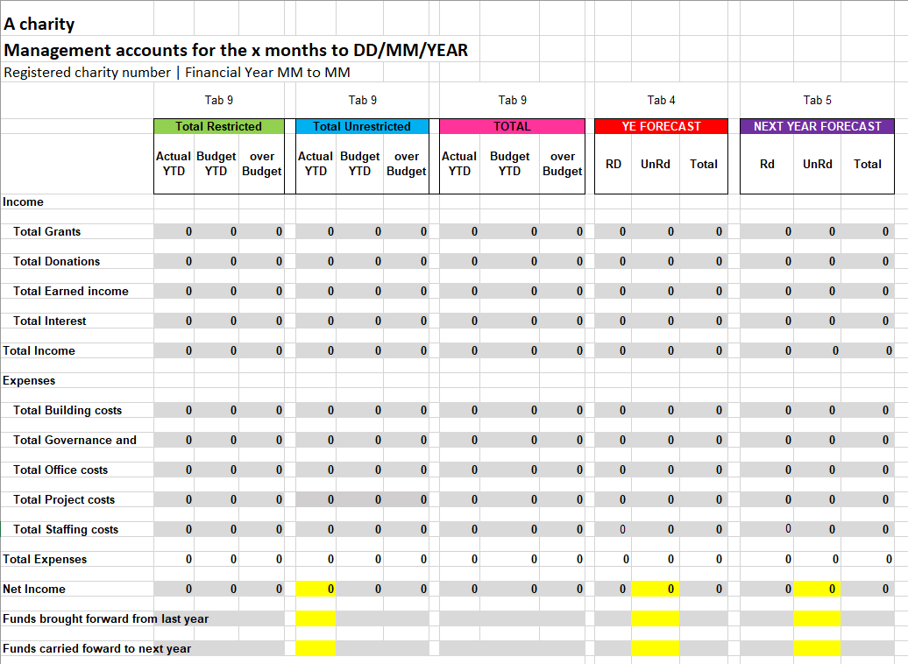


Slide 17

Preparing
Creativity and communication
in the face of uncertainty
Tuesday 25th April 2023
Restricted v unrestricted income
Short term v long term funding
Charitable costs v overhead costs
Certain v target income
Flexible v fixed costs
How to build reserves?
Ultimately, it is about scenarios

Slide 18
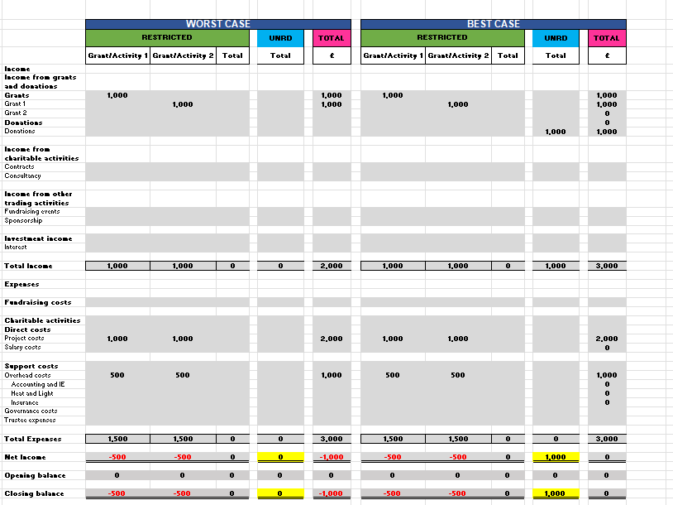

Slide 19
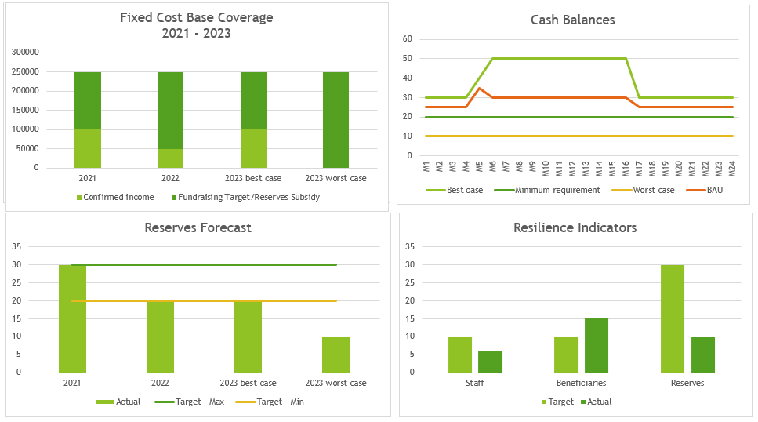


Slide 20
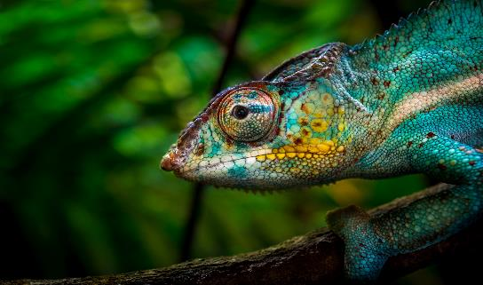

Adapting
Creativity and communication
in the face of uncertainty
Tuesday 25th April 2023
Evolution
Revolution

Slide 21
Adapting | 3 horizons
Sustainability
Horizon One
2023 - 24
Horizon Two
2024 - 25
Horizon Three
2025 - 26
Time
https://powerslides.com/powerpoint-business/business-models/mckinsey-three-horizons-model/

Slide 22


Responding
Creativity and communication
in the face of uncertainty
Tuesday 25th April 2023
Now
In good time

Slide 23
responding
Creativity and communication
in the face of uncertainty
Tuesday 25th April 2023
Near term and modest
Near term and significant
Far away and modest
Far away and significant
Make small changes now.
Raise income? Subsidise from reserves? Cut costs?
Make deep changes promptly
Contraction?
Stop a service? Merge? Close?
Change business model?
Start now to deliver in time
Could be expansion?
Make small changes in good time
Full cost recovery in place? Can cost recovery be improved? Can a modest new income stream be secured?

Slide 24
Creativity and communication
in the face of uncertainty
Tuesday 25th April 2023
4 steps to a more resilient financial future
Anticipate the shape of things to come with a forecast
Prepare for the most reasonable cases with shared scenarios
Adapt, by evolution or revolution, with 7th generation thinking
Respond/reimagine/reinvent in good time with a compass to guide us through
Anticipate | Prepare | Adapt | Respond

Slide 25
Common elephant traps
Creativity and communication
in the face of uncertainty
Tuesday 25th April 2023

Slide 26
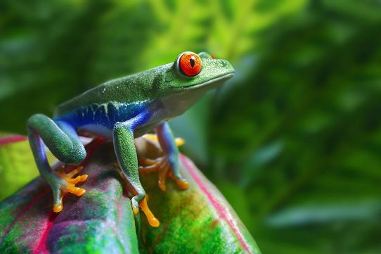

Common elephant traps
Are we boiling frogs?
Are we being strategic?

Slide 27


Common elephant traps
What is our risk appetite?
What is our risk tolerance?

Slide 28
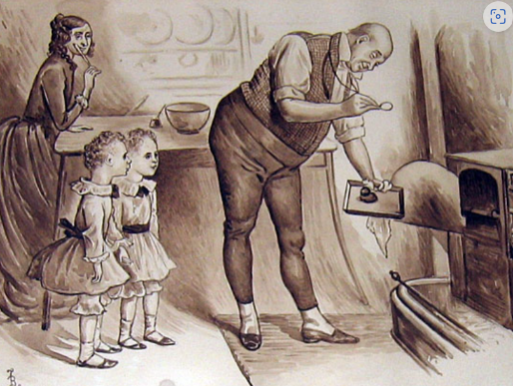

Common elephant traps
Something will turn up
A forecast isn’t a forecast without a spreadsheet

Slide 29


Common elephant traps
How is decision making made?
It takes a whole village

Slide 30
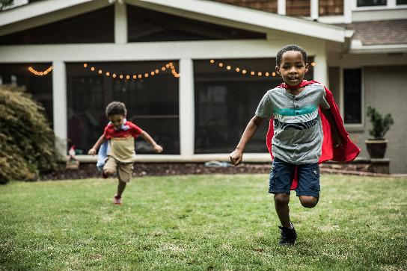
That’s it folks
Not all heroes wear capes, some run small charities

Slide 31
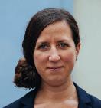
Creativity and communication
in the face of uncertainty
Tuesday 25th April 2023
09.30-09.45: “Just when we thought that things could not get any worse...”, Michele Price
09.45-10.30: Planning for financial uncertainty, Liz Pepler and Rachel Cooper
10.45-11.30: Be more creative to diversify your income, Laura Salisbury
11.45-12.30: Navigating the cost of living crisis with funder support, Mike Zywina
12.30-13.00: Lunch/Networking
13.00-13.45: Understanding what your audiences need to hear from you, Yasmin Glover
14.00-14.45: Mission, Culture and Crisis, Elizabeth Balgobin
15.00-15.45: The people perspective: uncertain times and impact on you and your employees, Sonia Wilson
15:45-16:00: Closing/questions/thanks
We hope you found ‘Planning for financial uncertainty’ with Liz and Rachel useful.
Your next session is ‘Be more creative to diversify your income’ with Laura at 10.45am.
#SCFConference

Slide 32
Creativity and communication
in the face of uncertainty
Tuesday 25th April 2023
Creativity and communication
in the face of uncertainty
Tuesday 25th April 2023
#SCFConference
Thank you for attending the
Small Charity Friendly Conference!
We hope you have found the sessions useful, and would be grateful if you could complete a short feedback form to help us to plan future support.

Slide 33







Disclaimer Any guidance provided herewith is illustrative only and is not intended to replace professional advice. Please consult an appropriately qualified professional adviser.
We are committed to open sharing and learning
We believe that the world's problems are too complex to be solved by anyone person or organisation. We also believe that working together we have the answers. Therefore, all our training and workshops are delivered under a Creative Commons License. Providing certain conditions, we are happy for others to share, use, and, critically, build upon our work. Our conditions are here //www.embracefinance.org.uk/open-working-commitment
Embrace Finance is a non-profit company limited by guarantee. Registered company number 11338373

Slide 34

IMPACT
Board role
and
Leadership role
Being strategic
Financially confident leadership
Financial
model
Financial
governance
Financial
strategy
Financial
storytelling
Financial
risk
Thriving
02 Small Charity Financial Management
How to stop worrying and learn to love charity finance
Leadership role and
Finance role
Being intentional
Early Warning System
Active Reserves Management
Financial Resilience
Multi Year Planning
Live Risk Management
Financial Sustainability
Activity Based Costing
Intentional Decision Making
Mission Money Mapping
Full Cost Recovery
Income generation
Unit cost and cost analysis
Sustaining
Finance role
Being in control
Financial Management
Cash and Banking
Annual accounting and
Year-End
Bookkeeping
Management reporting
Controls
Compliance and Tax
Budgeting and forecasting
Payroll and Pensions
Assets and Liabilities
Surviving
Creative Commons License Can be shared and used for non commercial purposes with accreditation

