Slide 1


Be more creative to diversify
your income
Notes:
Log into Zoom at 10.35am - https://us02web.zoom.us/j/83106775684
10.45 to 11.30am
25 min presentation
15 mins questions
Opening slide;
Thank them for joining the inaugural conference of the Small Charity Friendly Collective
Refer to talks coming up throughout the whole day
- Manage expectations: This is not a how-to, practical workshop. But I hope to highlight the value of income diversity during times of uncertainty, which can only be achieved through trial and error and taking some risks. I’m hoping to challenge your mindset overall.

Slide 2
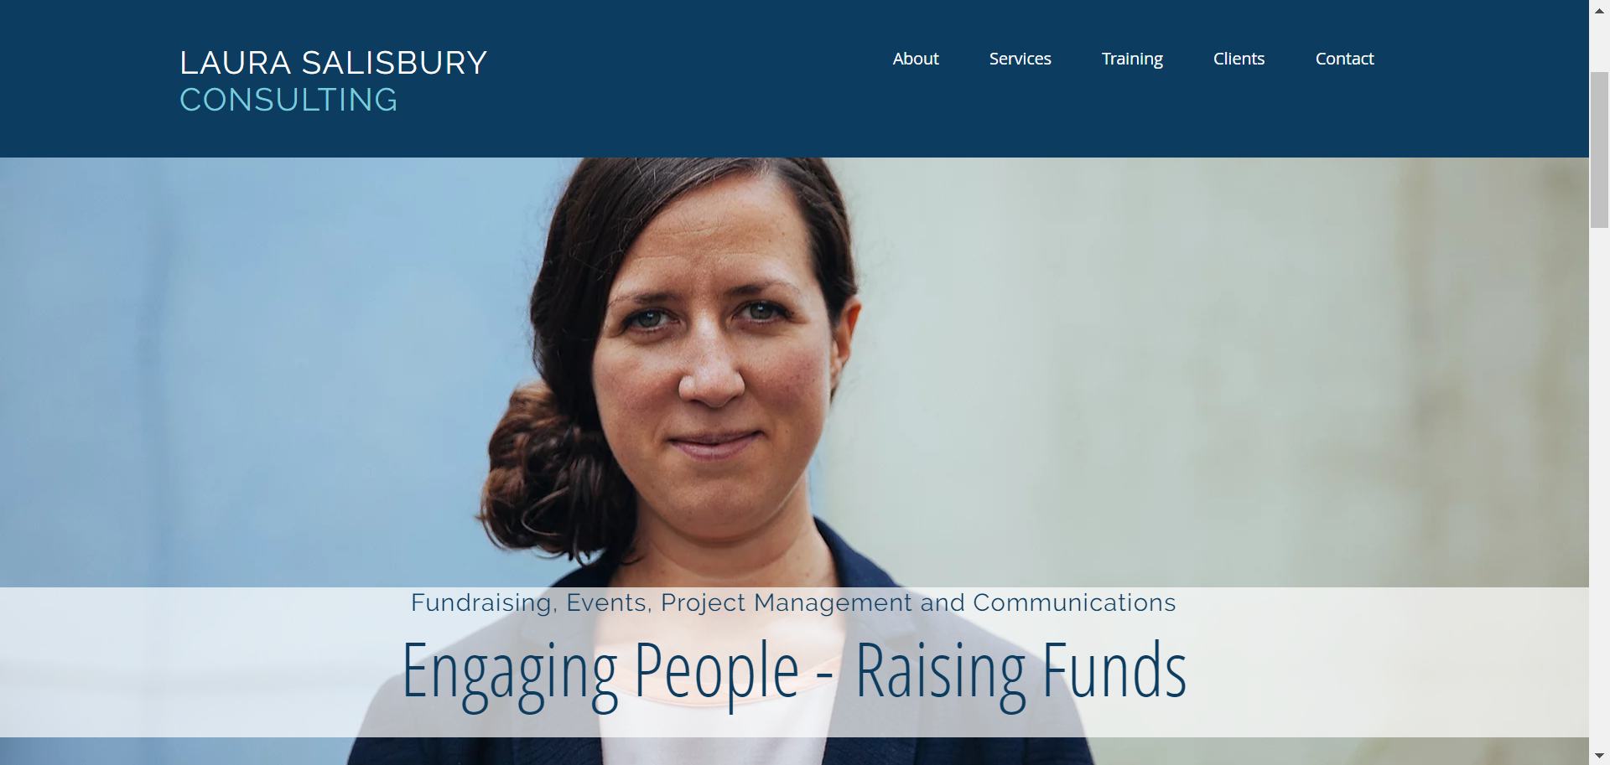
About me
Notes:
Nearly 20 years experience working for charities large and small
Since working as a consultant I have often helped organisations to consider how to diversify their income – and begin doing things for the first time.
Specialise in raising unrestricted income from the general public

Slide 3
Agenda
What is creativity & why focus on it
Linking this to income diversification
Some examples
Notes:
At the end of this talk I hope I’ve shown;
Being creative requires the courage to let go of certainty, and be willing to fail.
Now, more than ever, its prudent to diversify your income streams.
If diversifying into public fundraising. Remember that raising income from the general public will take time, and you may need to engage with new technologies, and consider behavioural change.

Slide 4
What is creativity?
the use of imagination or original ideas to create something; Inventiveness. (source Oxford Languages)
a phenomenon whereby something new and valuable is formed. The created item may be intangible…or a physical object. (source Wikipedia)

Slide 5
“Creativity requires the courage to let go of certainty” – Erich Fromm

Slide 6
Why you should consider innovative fundraising approaches now?
Fundraising is getting harder
Less people are giving since the start of the cost of living crisis: 4.9 million fewer people donated to charity from Jan-April 2022 (CAF).
Income from both central (3%) & local government (9%) declined in 2022, compared to the previous year (NCVO).

Slide 7
2. The world is rapidly changing, and the future is uncertain
“a fundamental behavioural change is required across organisations, across civil society, to meet an increasingly uncertain and challenging future”
Julia Unwin CBE, Chair, Civil Society Futures
Notes:
Civil Society Futures was a time-limited independent enquiry in the future direction and goals of civil society in the UK.
Civil Society Futures Report states of its pioneering programme encouraging organisations to be future focussed. The first core principle should be: “Participants need an opportunity to try out new things, not be afraid of failure or sharing where things didn’t go well”
Source: The Future Charity Report

Slide 8
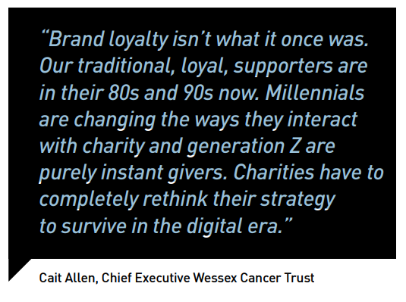
3. It’s essential to keep up with behavioural & technological change
Notes:
Speak more generally about point three first. Then go to the quote.
Source: The Future Charity report

Slide 9
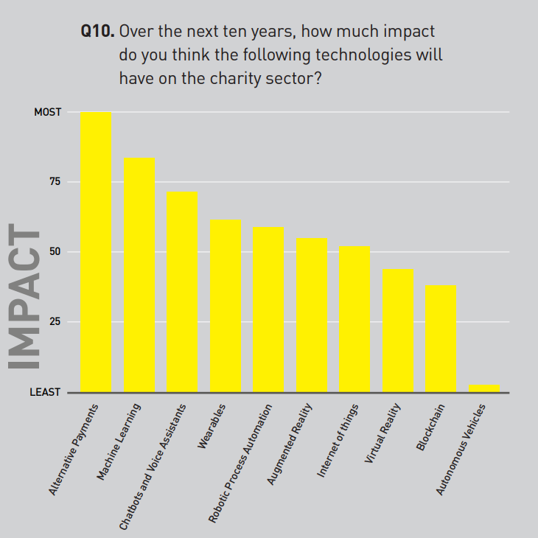
Notes:
Speak to two examples:
Alternative payments – evolving ways of receiving cash ie. card payments, e-wallets such as PayPal, contactless payments, mobile wallets using QR codes and SMS to transfer funds.
ChatGBT, which is an artificial intelligence chatbot. See articles on SOFII – but the potential is unknown at this stage. Could be helpful with the generation of ideas.
Source: The Future Charity Report

Slide 10
Small charities
Opportunities & barriers to creativity
Firefighting – staff capacity & funding
Creative inspiration thrives when we can be quiet and relaxed – and there isn’t a sense of urgency or threat
The Future Charity Report states top three barriers across the voluntary sector include;
- Low appetite for risk at a leadership level
- Organisational culture
- The challenges of embracing new technology
Notes:
1. Fire Fighting; Due to having low capacity and funding challenges, being innovative is probably seen as a luxury. A sense of ‘fire-fighting’ is the word I often hear when working with smaller charities.

Slide 11
4. Being agile is a benefit
5. Specialist volunteers to support with new technology
6. Lower turnover means lower risk
Notes:
Example of working with PR/Comms expert at CU. She managed the PR for the Millenium Dome project (which later became the O2).

Slide 12
“Successful innovation requires failure. Resources should be set aside for conducting experiments where no immediate return on investment is expected” (Future Charity Report)

Slide 13
What is income diversification?
To establish multiple lines of income, from a range of sources is income diversification
Because different industries and income sources will be affected by market conditions differently
Therefore, it creates organisational resilience
The ideal income mix will vary from charity to charity
It is important to be realistic about how long it might take to build up a new income stream (e.g. regular giving could make profit in year 2 or 3)
Notes:
Examples of ideal income mix:
CFR highest income stream for hospices and many specific orgs such as Muscular Dystrophy which is 2/3rds CRF.
Trading and Earned income can be high for some organisations such as Motivation Charitable Trust that raises c. 50% turnover from selling wheelchairs through a CIC.

Slide 14
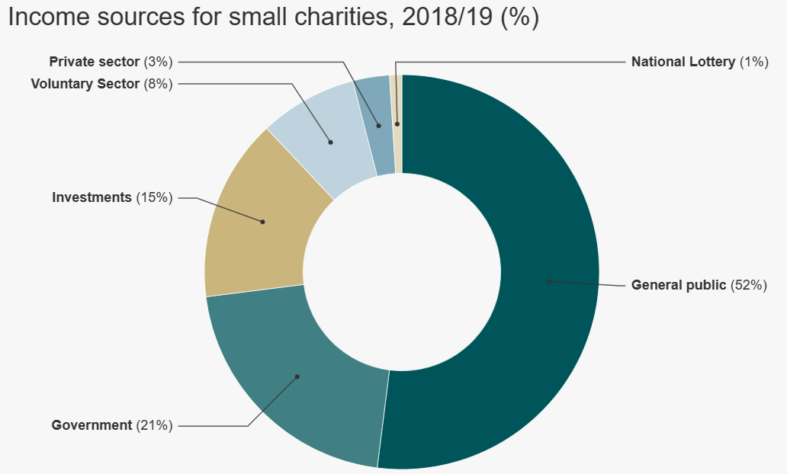
Notes:
Taken from Small Charities Data | Small Charities Data (but the data source is NCVO)
Take about top three sources.

Slide 15
Using creative approaches to diversify
Trustee: Could you consider scheduling a board meeting that tries to identify how you view risk, and if there is budget available for fundraising innovation?
CEO, or senior leader: Perhaps you can consider how your organisation deals with failure, and consider how this might be suppressing the creativity of your team.
Fundraising staff member: Could you consider spending 80-90% of your time focussed on income generation that is tried & tested, and prioritise some of your time testing new ideas to build up new income streams.

Slide 16
Using creative approaches to diversify
Stage One: Spend time in a new / unusual environment to generate ideas – find ‘plants’ or creative people for this
Stage Two: Choose your top ideas, and develop in more detail
Stage Three: Finally, decide on one or two ideas to implement – find practical, ‘implementers’ for this stage
If possible, test a prototype with a small group of people first to keep this low risk.
Notes:
Mention your creativity training here.
Personality types from Belbin.
Concept Note process at Lepra for demonstrating stage two.

Slide 17
Don’t forget:
Fundraising Essentials
Relationships
Focus on your Case for Support
Products & audiences
Notes:
Examples of products =
Sponsorship package for corporates
Crowdfunding appeal for your online audiences
Special event for your high level donors

Slide 18

Case Study: ADD International
Notes:
Pandemic forced us to innovate & highlighted how quickly we could adapt
Virtual events and flexible funding
Demonstrates that income diversification is key – because you can’t predict the future

Slide 19

Case Study: Ride for Freedom
Notes:
When considering new income streams:
Start with your purpose / cause
Convert your supporters & closest relationships into your donors – and make a variety of different asks if appropriate.

Slide 20
Summary
Being creative requires the courage to let go of certainty, and be willing to fail.
Now, more than ever, it’s prudent to diversify your income streams.
If diversifying into public fundraising. Remember that raising income from the general public will take time, and you may need to engage with new technologies, and consider behavioural change.
Finally, if trying new things, please always remember to fundraise ethically & legally
Notes:
Mention the Fundraising Regulator and the fundraising code.

Slide 21
Resources
Fundraising and Innovation
SOFII
Income Diversification
Directory of Social Change
Chartered Instituted of Fundraising
NCVO

Slide 22
Thank you – and questions?
Feel free to stay connected, and find out more:
laura@laurasalisbury.co.uk
www.laurasalisbury.co.uk
www.linkedin.com/in/laura-salisbury/
www.linkedin.com/company/small-charity-friendly-collective
Notes:
Think about how you will introduce Mike at this point – as the next speaker. He will support with practical evidence-based ideas to encourage trusts and foundations to support your projects despite the rising costs you are facing.

